Slide 1
Learning Objective
I will be able to solve probability using probability tables
Success Criteria
At the end of the lesson, I will be able to:
be able to solve probability using probability tables.

Slide 2
Guided Practice
A summary of probability table:
 | Event B | Event B’
Event A
Event A’

Slide 3
Guided Practice
A summary of probability table:
 | Event B | Event B’
Event A
Event A’

Slide 4


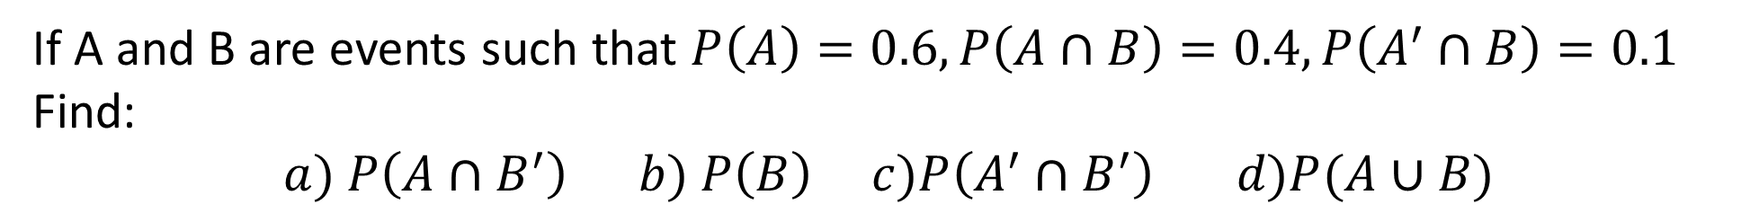











Guided Practice
If A and B are events such that $P\left(A\right)=0.6, P\left(A∩B\right)=0.4, P\left(A^{′}∩B\right)=0.1$
Find:
$$a) P\left(A∩B^{′}\right) b) P\left(B\right) c)P\left(A^{′}∩B^{′}\right) d)P(A∪B)$$
$$=0.2$$
$$=0.5$$
$$=0.3$$
$$=1−0.3=0.7$$
 | B | B’
A
A’
$$0.4$$
$$0.2$$
$$0.6$$
$$0.1$$
$$0.3$$
$$0.4$$
$$0.5$$
$$0.5$$
$$1$$

Slide 5



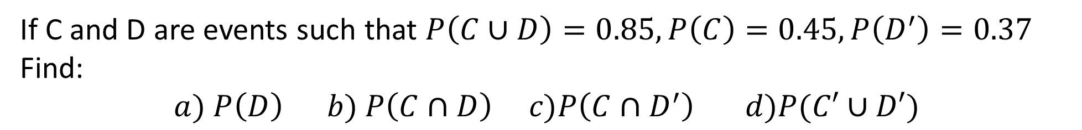









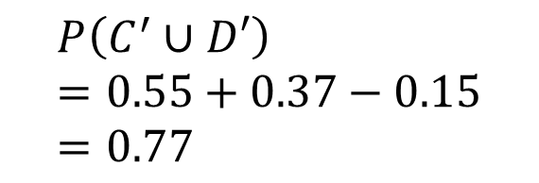


Guided Practice
If C and D are events such that $P\left(C∪D\right)=0.85, P\left(C\right)=0.45, P\left(D^{′}\right)=0.37$
Find:
$$a) P\left(D\right) b) P\left(C∩D\right) c)P\left(C∩D^{′}\right) d)P(C′∪D′)$$
$$=1−0.37=0.63$$
$$P\left(C∩D\right)=P\left(C\right)+P\left(D\right)−P(C∪D)$$
 | D | D’
C
C’
$$=0.45+0.63−0.85$$
$$=0.23$$
$$0.23$$
$$0.22$$
$$0.45$$
$$P\left(C∩D′\right)=0.22$$
$$0.4$$
$$0.15$$
$$0.55$$
$$P\left(C^{′}∪D′\right)=0.55+0.37−0.15=0.77$$
$$0.63$$
$$0.37$$
$$1$$

Slide 6
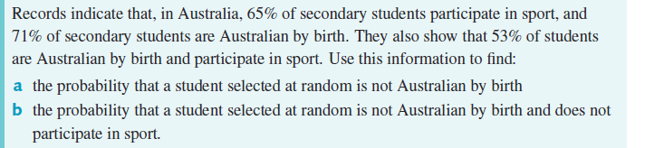


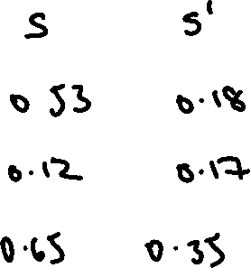
Guided Practice
a) $P\left(Not Australian by birth\right)=1−0.71=0.29$
b) $P\left(Not Australian by birth∩no sport\right)=0.17$

Slide 7
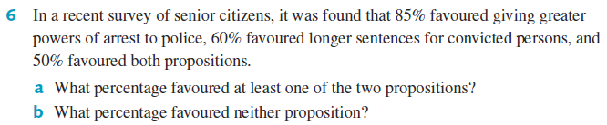



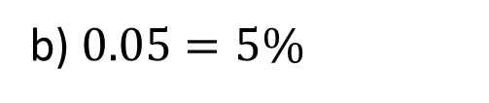



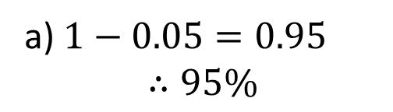







Guided Practice
$$P$$
$$P′$$
a) $1−0.05=0.95$ $$∴95\%$$
$$S$$
$$0.5$$
$$0.1$$
$$0.6$$
$$S′$$
$$0.35$$
$$0.05$$
$$0.4$$
b) $0.05=5\%$
$$0.85$$
$$0.15$$
$$1$$

Slide 8
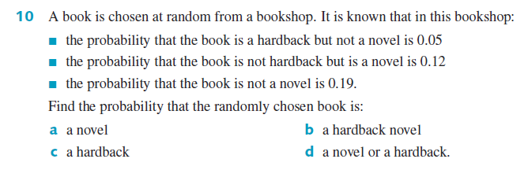


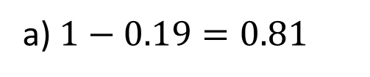
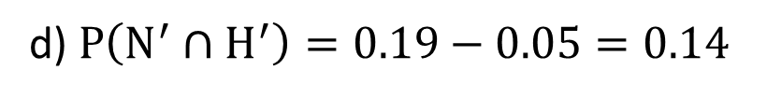




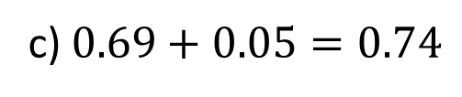




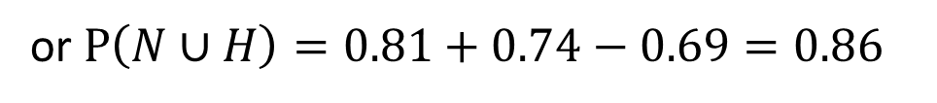

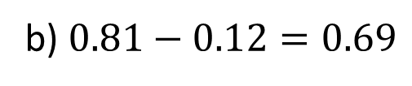


Guided Practice
a) $1−0.19=0.81$
$$H$$
$$H′$$
b) $0.81−0.12=0.69$
$$N$$
$$0.69$$
$$0.12$$
$$0.81$$
c) $0.69+0.05=0.74$
$$N′$$
$$0.05$$
$$0.14$$
$$0.19$$
d) $P\left(N^{′}∩H^{′}\right)=0.19−0.05=0.14$
$$0.74$$
$$0.26$$
$$1$$
$$P\left(N∪H\right)=1−0.14=0.86$$
or $P\left(N∪H\right)=0.81+0.74−0.69=0.86$

Slide 9
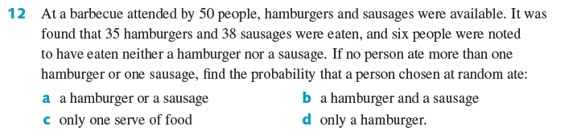


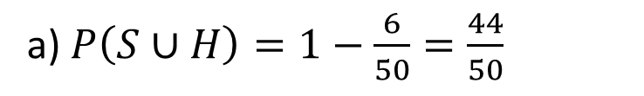
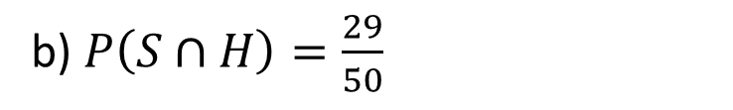




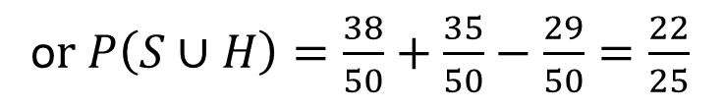




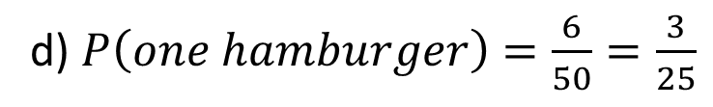

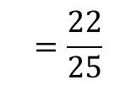


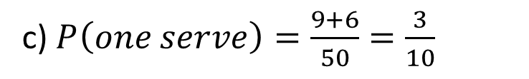
Guided Practice
a) $P\left(S∪H\right)=1−\frac{6}{50}=\frac{44}{50}$
$$H$$
$$H′$$
$$=\frac{22}{25}$$
$$S$$
$$29$$
$$9$$
$$38$$
o$r P\left(S∪H\right)=\frac{38}{50}+\frac{35}{50}−\frac{29}{50}=\frac{22}{25}$
$$S′$$
$$6$$
$$6$$
$$12$$
b) $P\left(S∩H\right)=\frac{29}{50}$
$$35$$
$$15$$
$$50$$
c) $P\left(one serve\right)=\frac{9+6}{50}=\frac{3}{10}$
d) $P\left(one hamburger\right)=\frac{6}{50}=\frac{3}{25}$

Slide 10
Independent Practice
Complete Ex 9E

